Slide 1
Penetration testing
Andrew, John, Zach, Omar

Slide 2
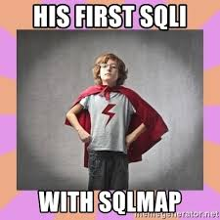

SQLMAP
Sqlmap is an open source software that is used to detect and exploit database vulnerabilities and provides options for injecting malicious codes into them.

Slide 3
Tools used to Penetrate
SQLMAP
Data Parser
OWasp zap
BurpSuite

Slide 4
Vulnerabilities Hacked
Successfully able to use SQLMAP to obtain Web Application and Database technologies and versions (Nginix, PHP 5.3.10 And MySQL >=5.0)

Slide 5
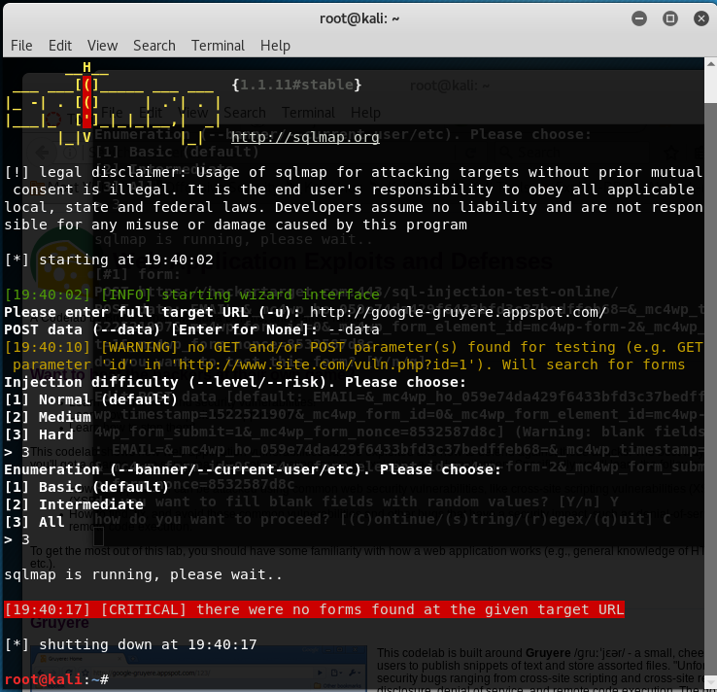
Penetration 1
Notes:
google-gruyere.com

Slide 6
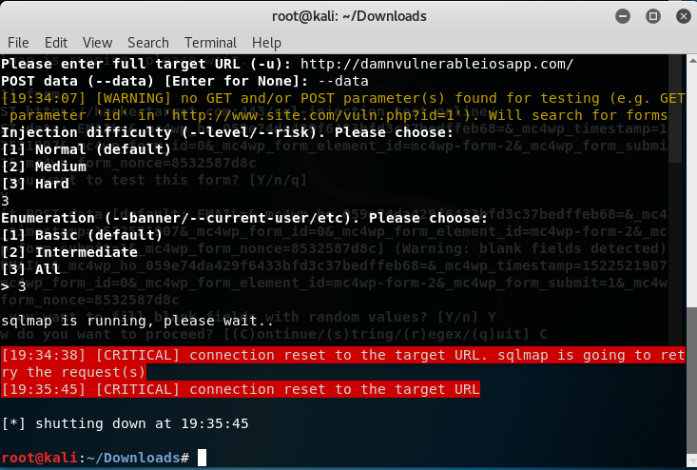
Penetration 2
Notes:
damnvulnerableapp.com

Slide 7
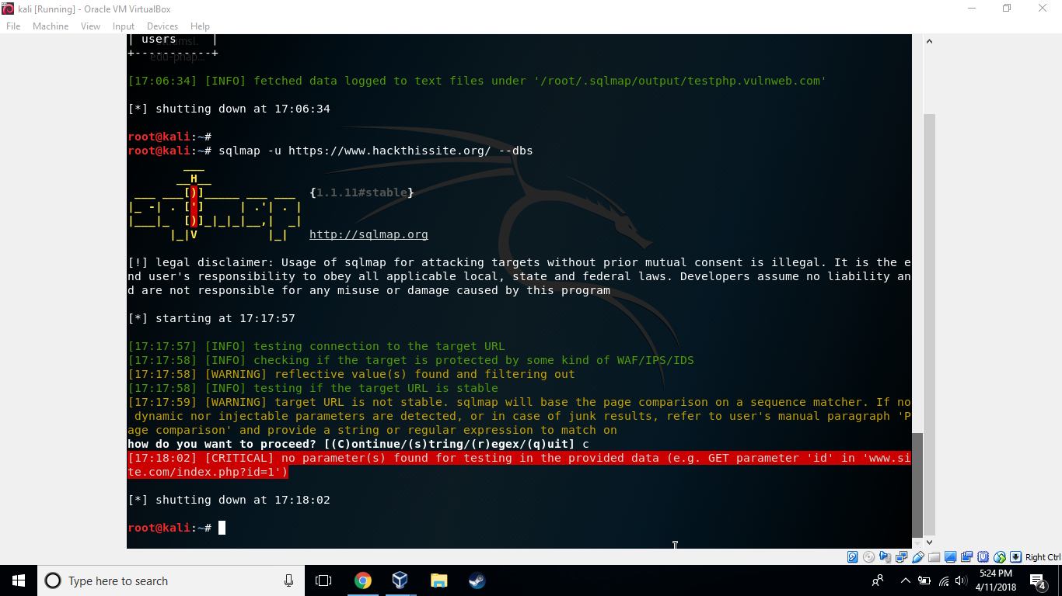
Penetration 3

Slide 8
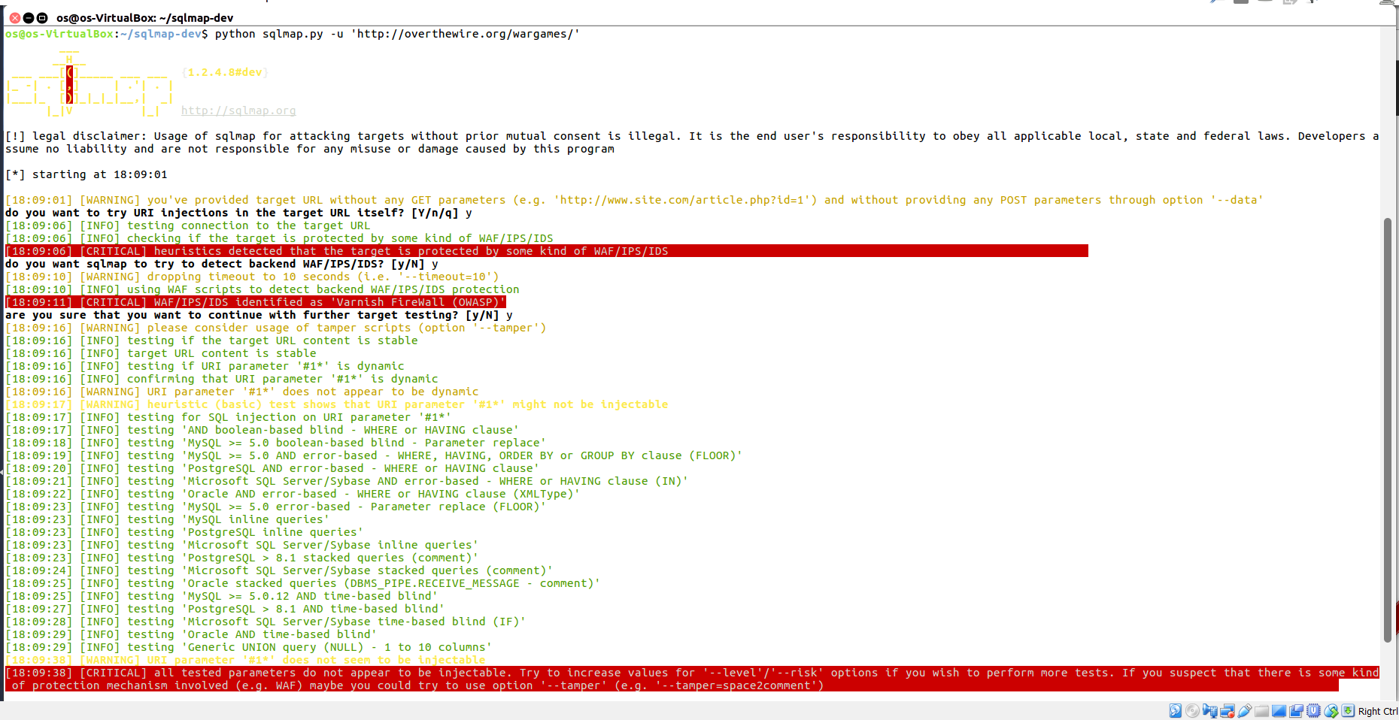
Penetration 4
Notes:
overthewire

Slide 9
Successful penetrations

Slide 10
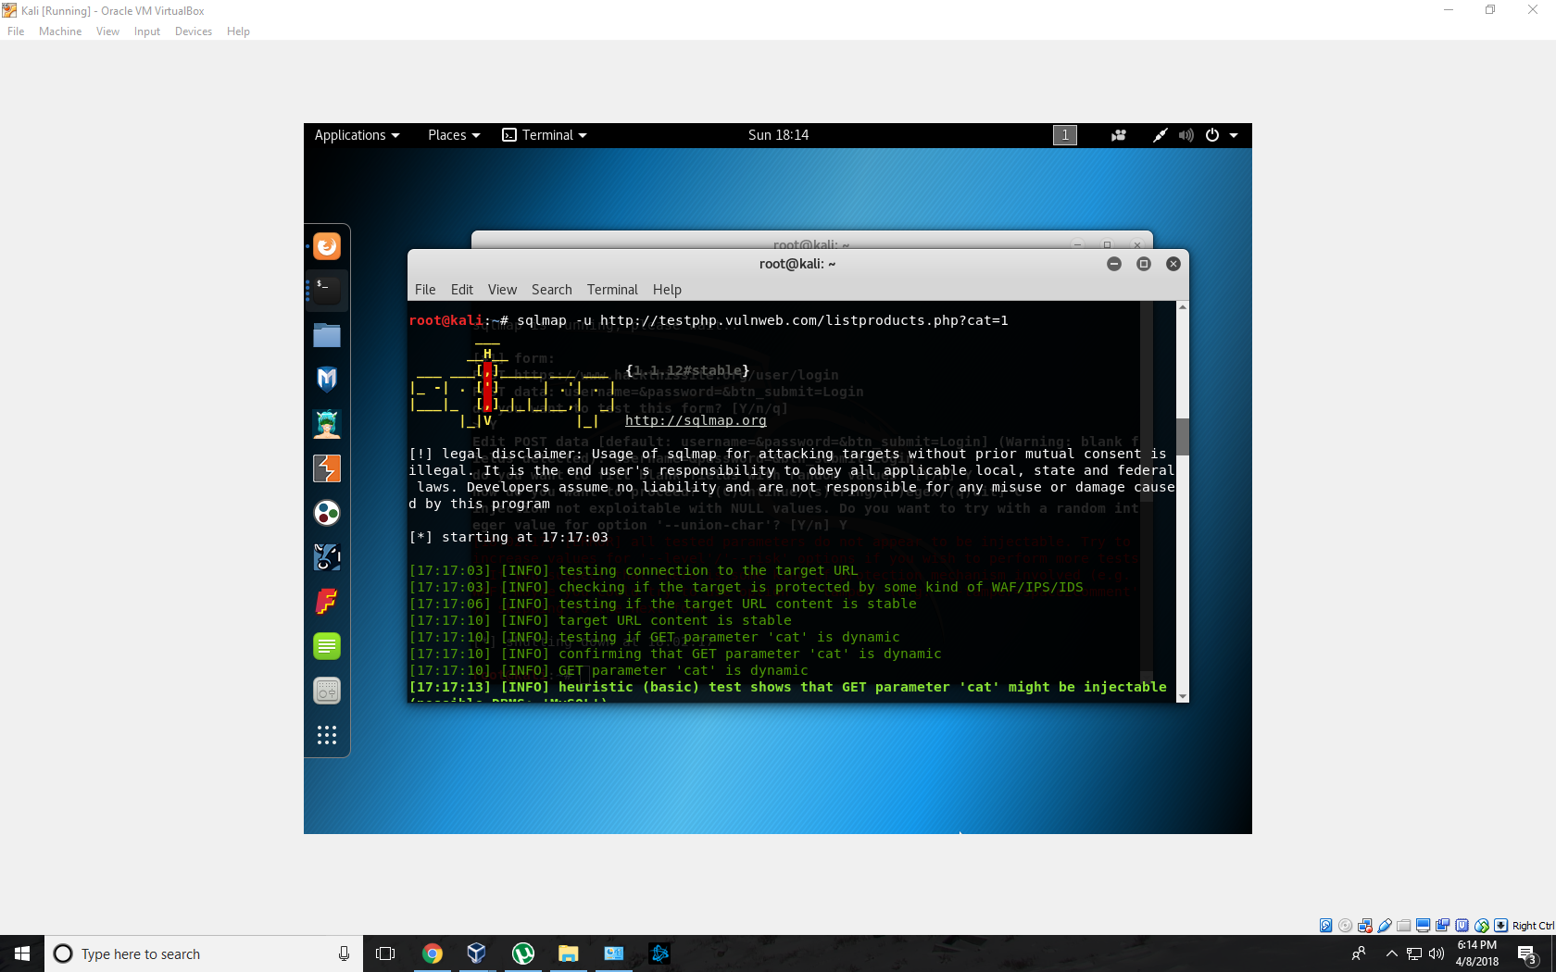
Penetration 5

Slide 11
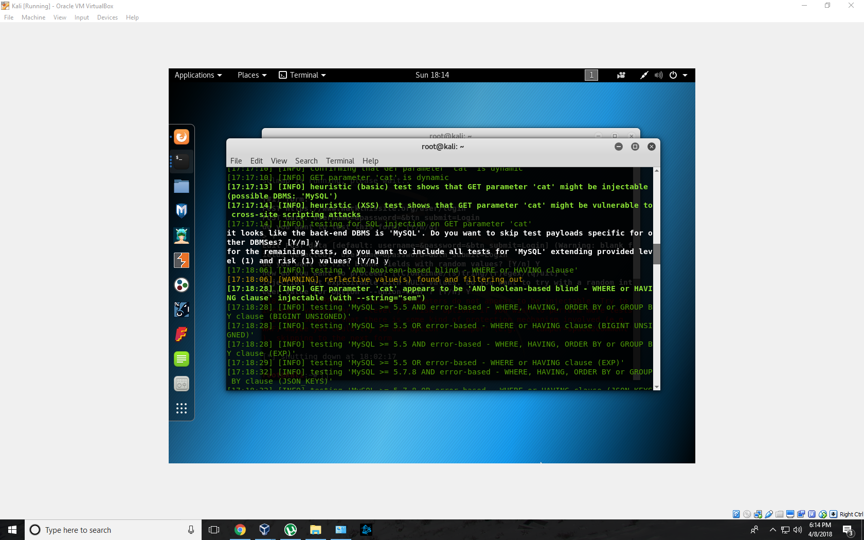
Penetration 5 cont

Slide 12
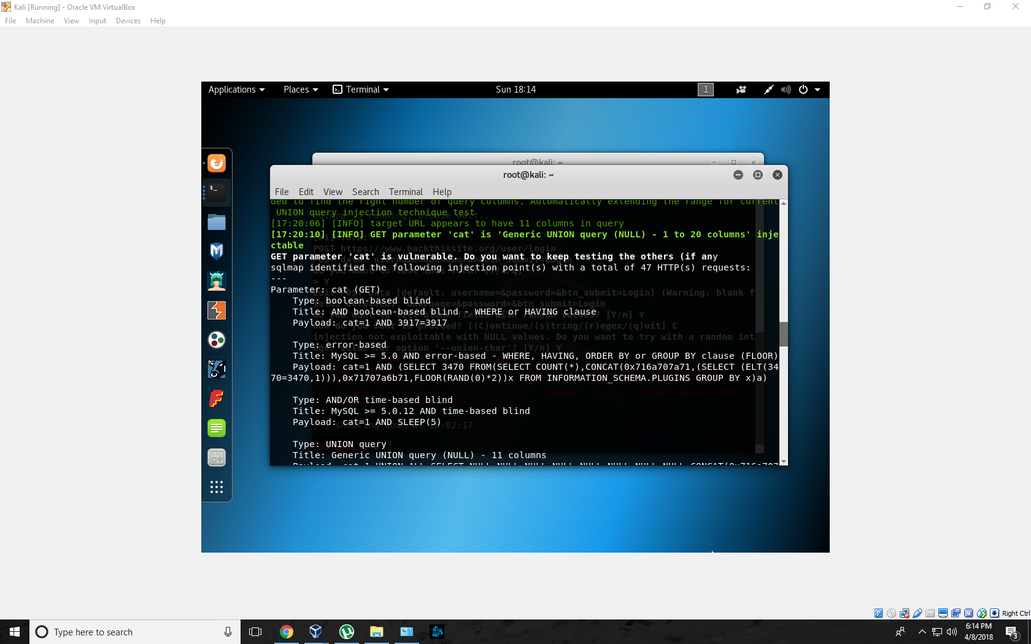
Penetration 5 cont

Slide 13
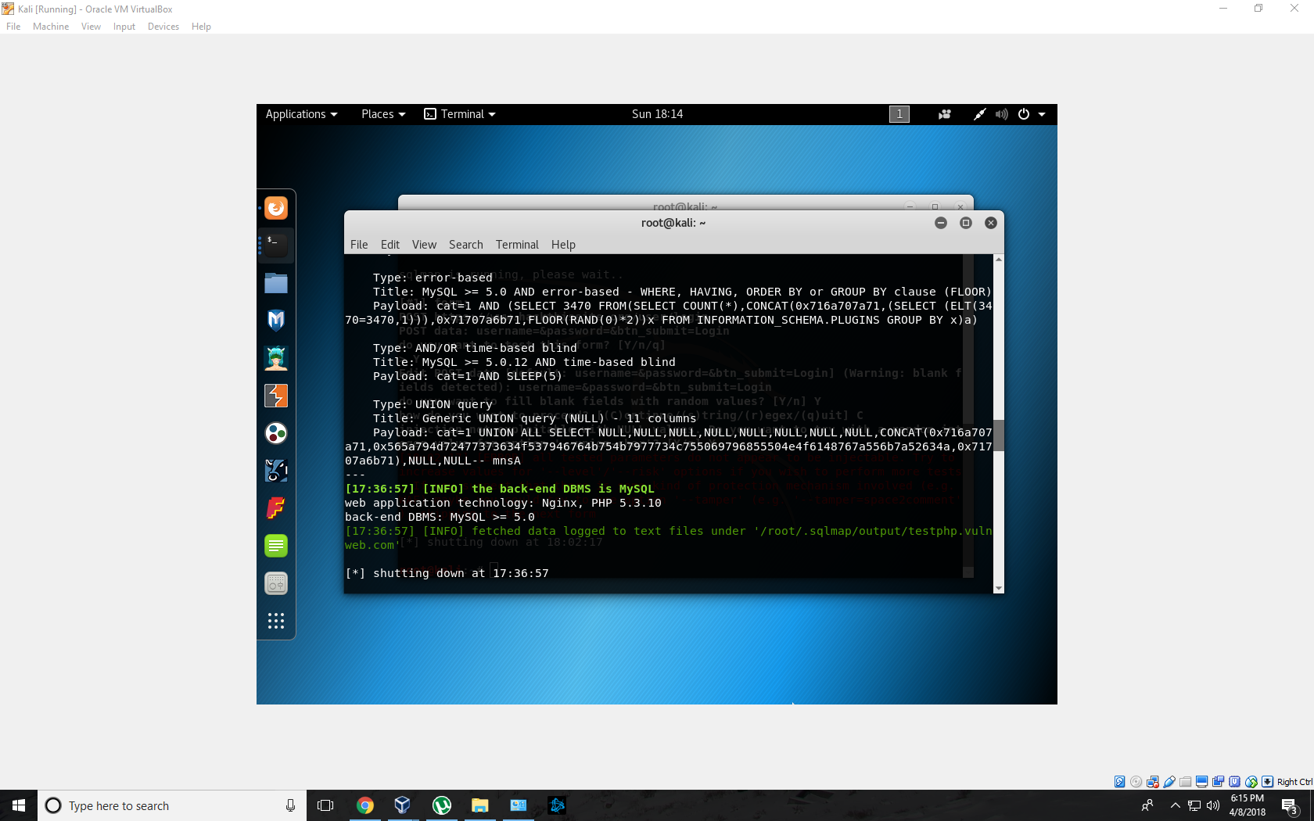
Penetration 5 continued and completed

Slide 14
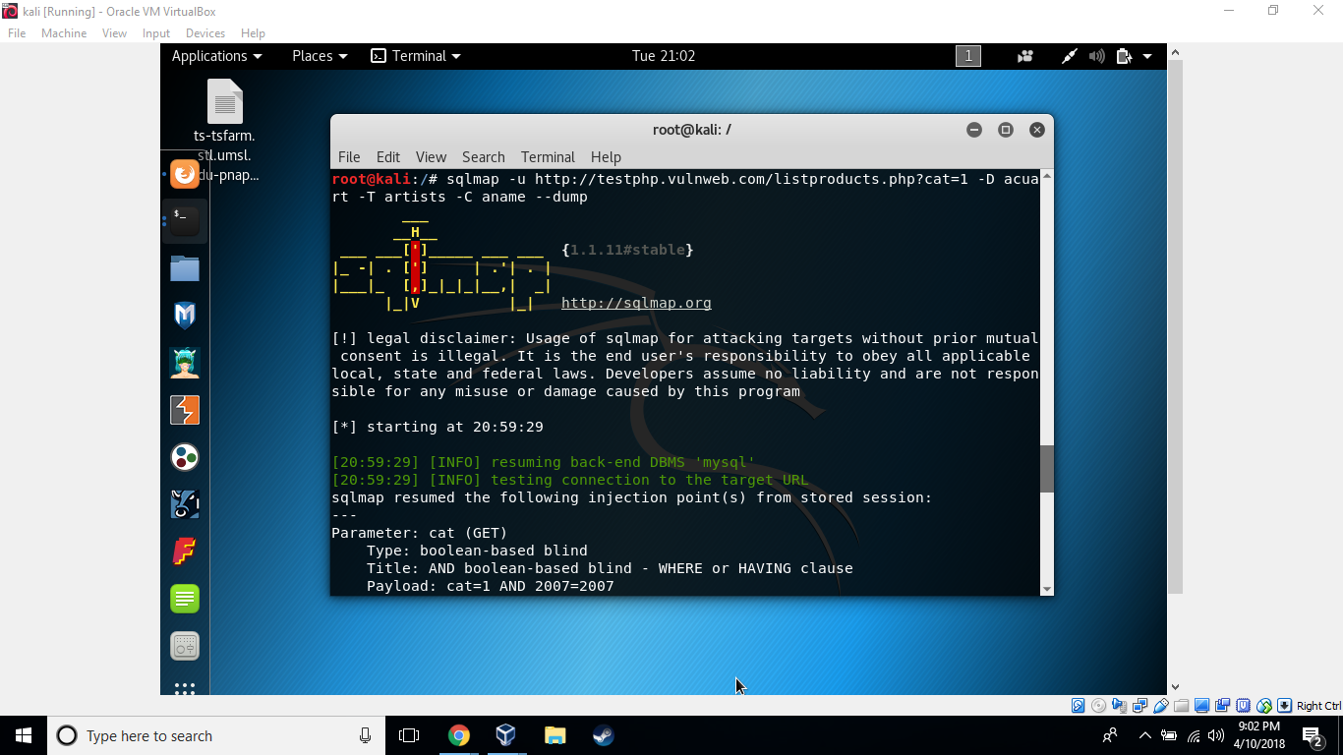
Penetration 5a

Slide 15
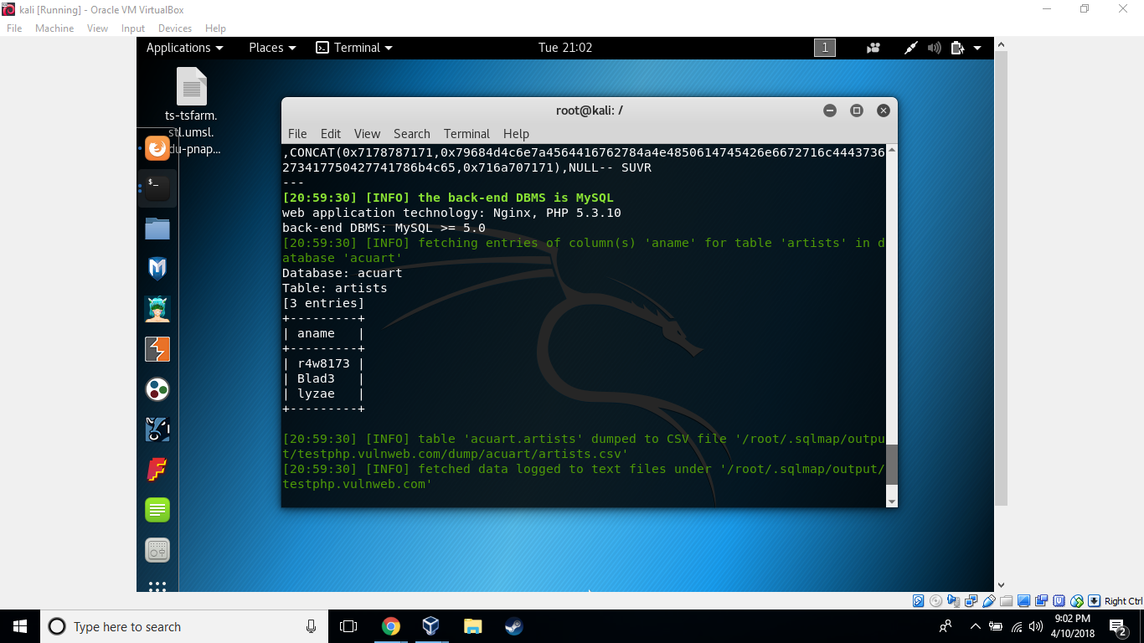
Penetration 5a continued

Slide 16
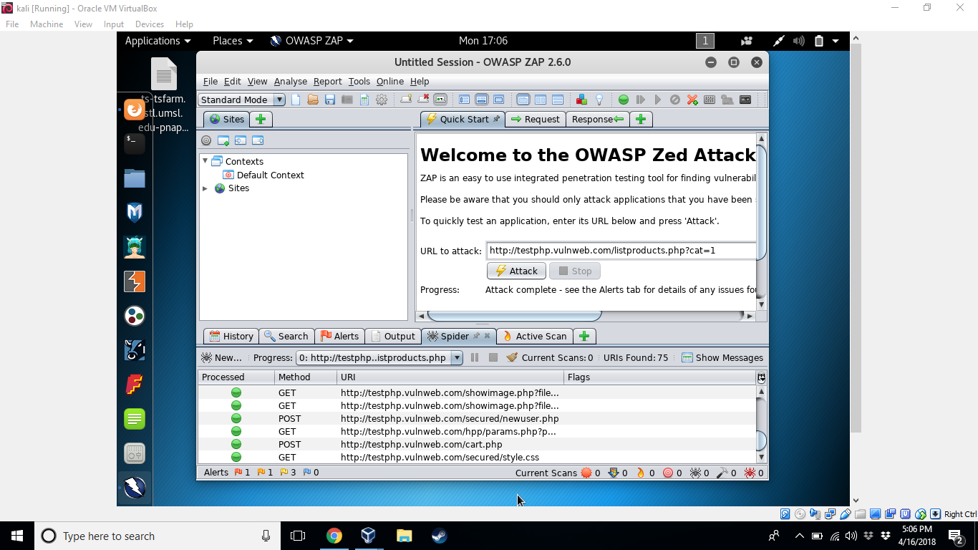
Penetration 6

Slide 17
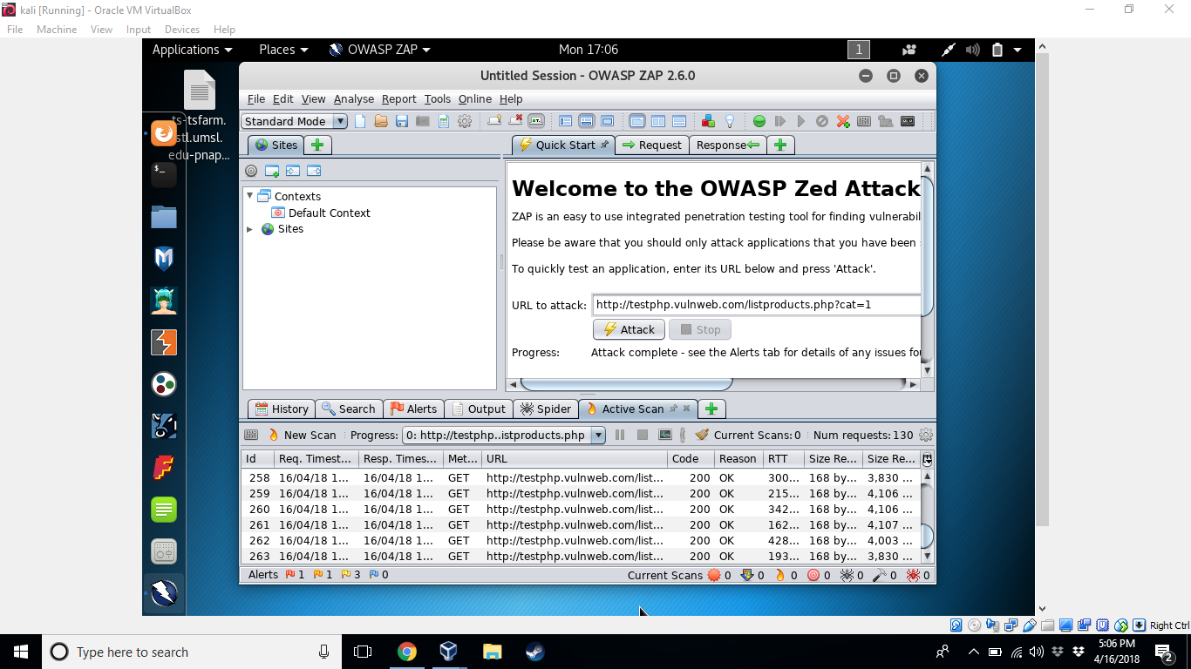
Pentration 6 cont

Slide 18
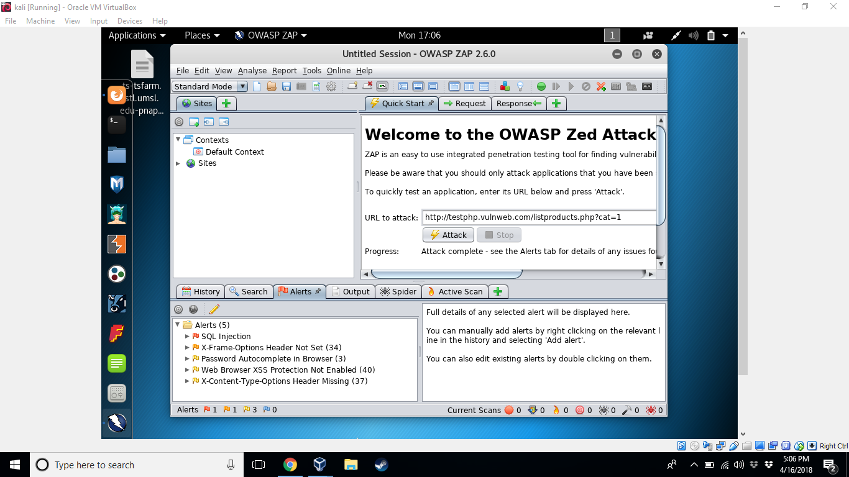
Penetration 6 cont

Slide 19
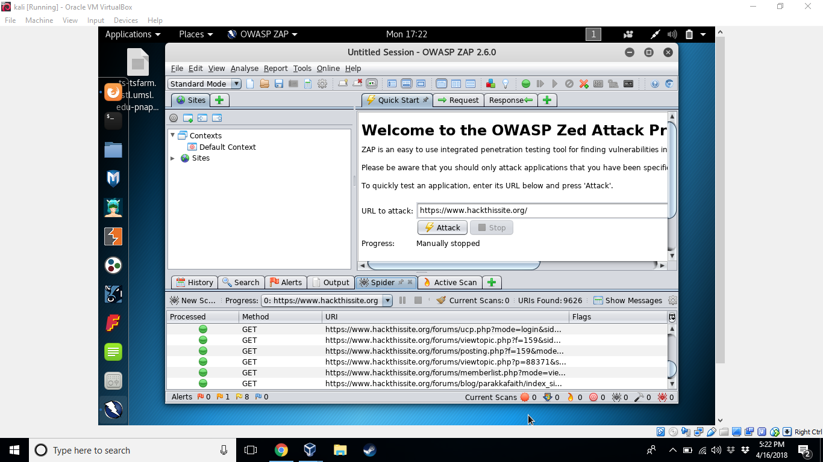
Penetration 7

Slide 20
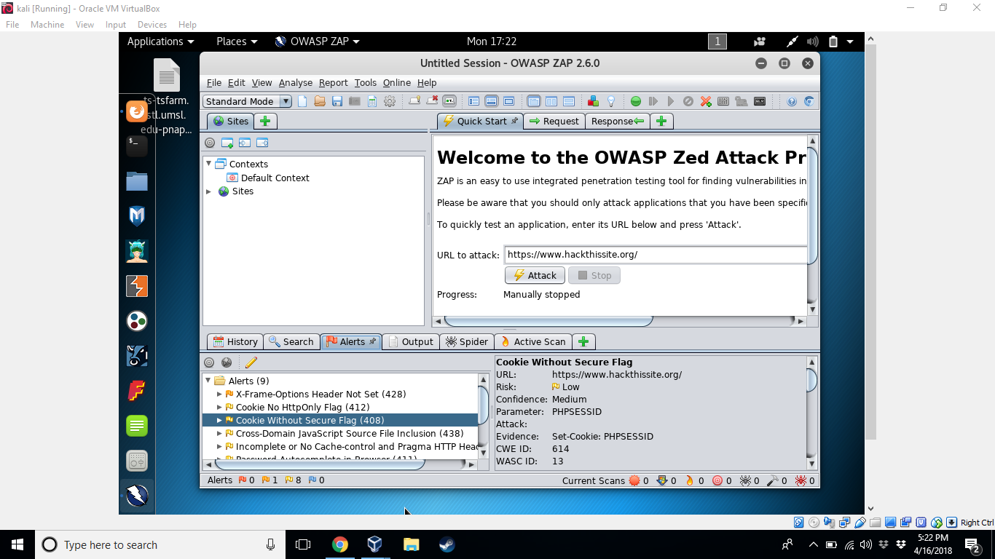
Penetration 7 cont

Slide 21
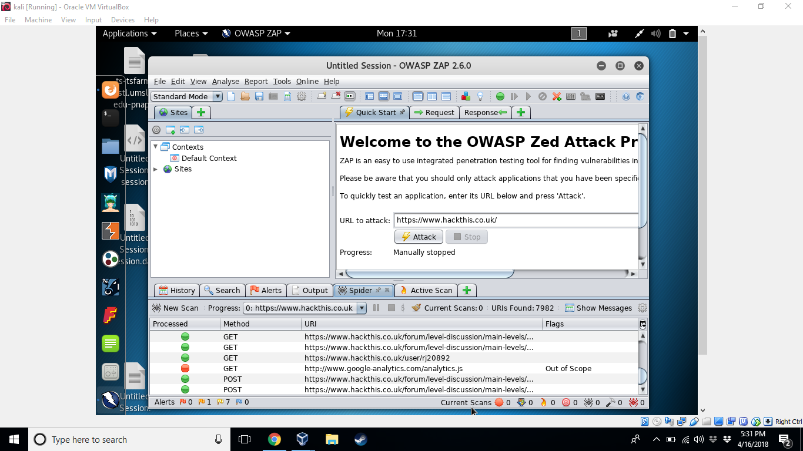
Penetration 8

Slide 22
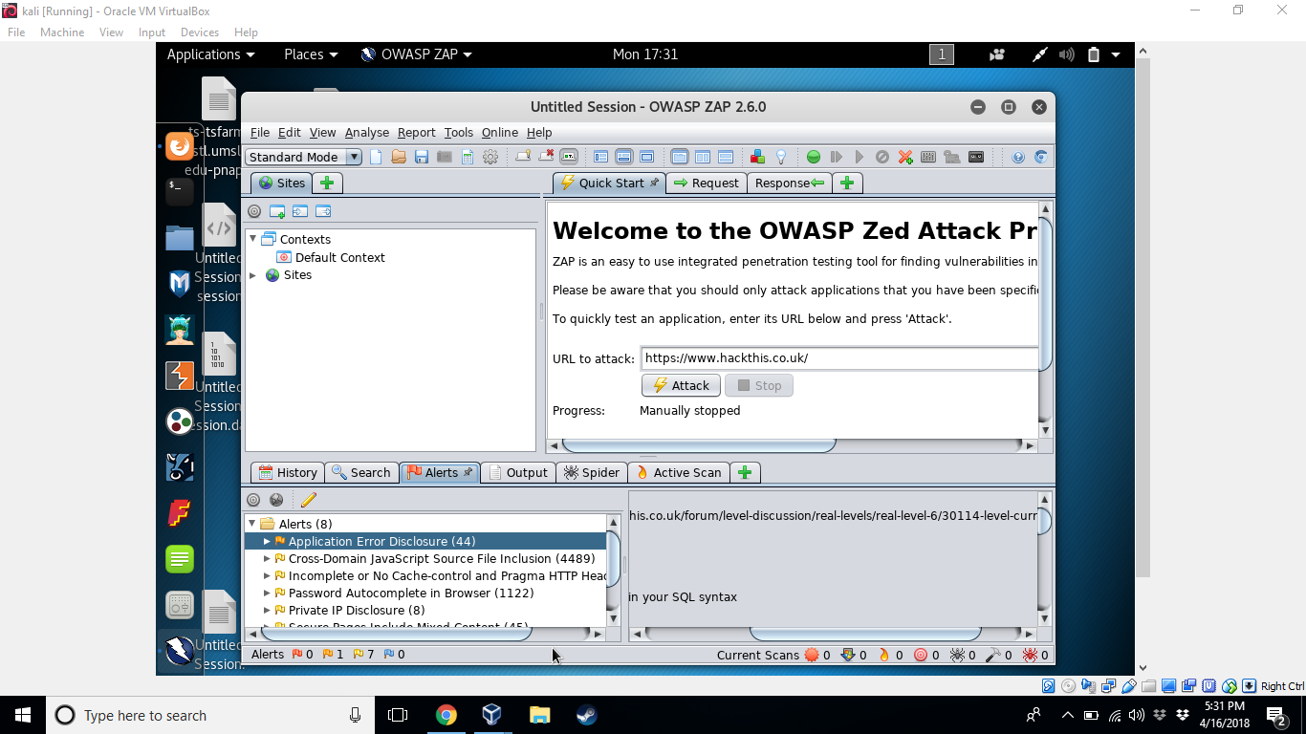
Penetration 8 cont

Slide 23
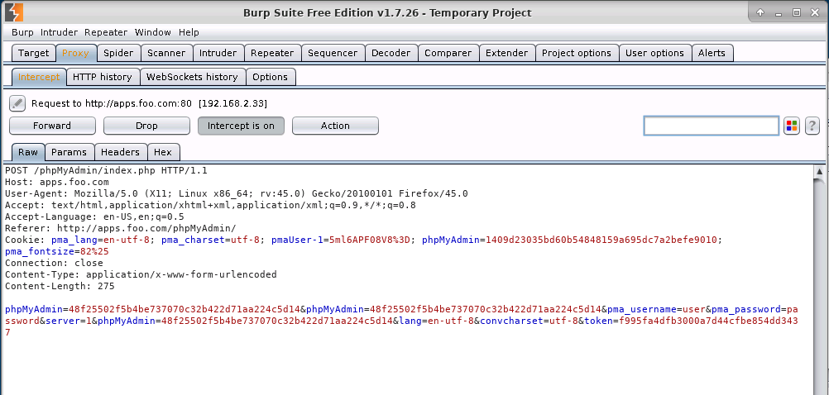
Penetration 9
Notes:
Burp suite picked up a post request to apps.foo.com/phpMyAdmin/

Slide 24
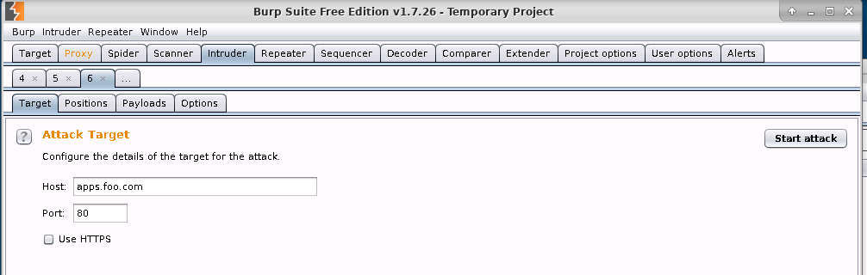
Penetration 9 cont
Notes:
In burp suite I sent the gathered information to the intruder tab that automatically filled ou the host and port

Slide 25
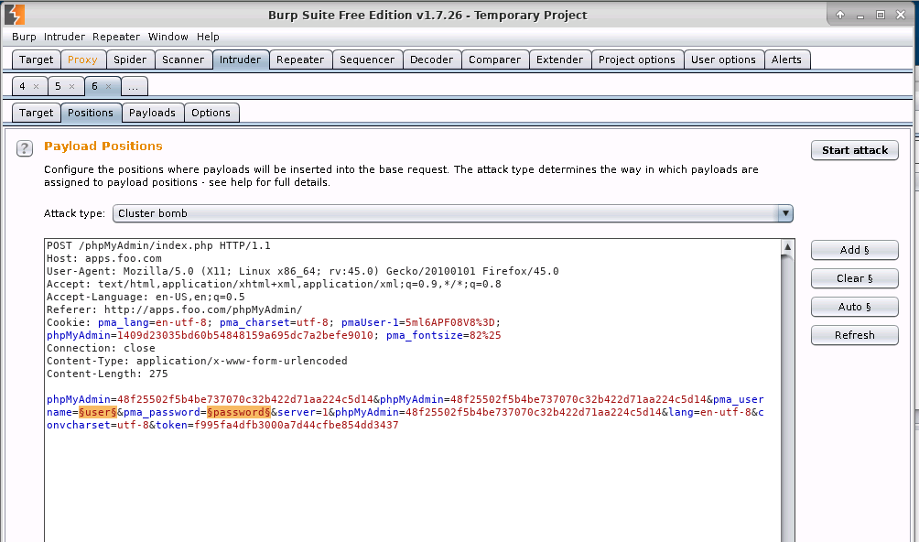
Penetration 9 cont
Notes:
Cleared the hi lighted fields then hi lighted our own which is the user and password

Slide 26
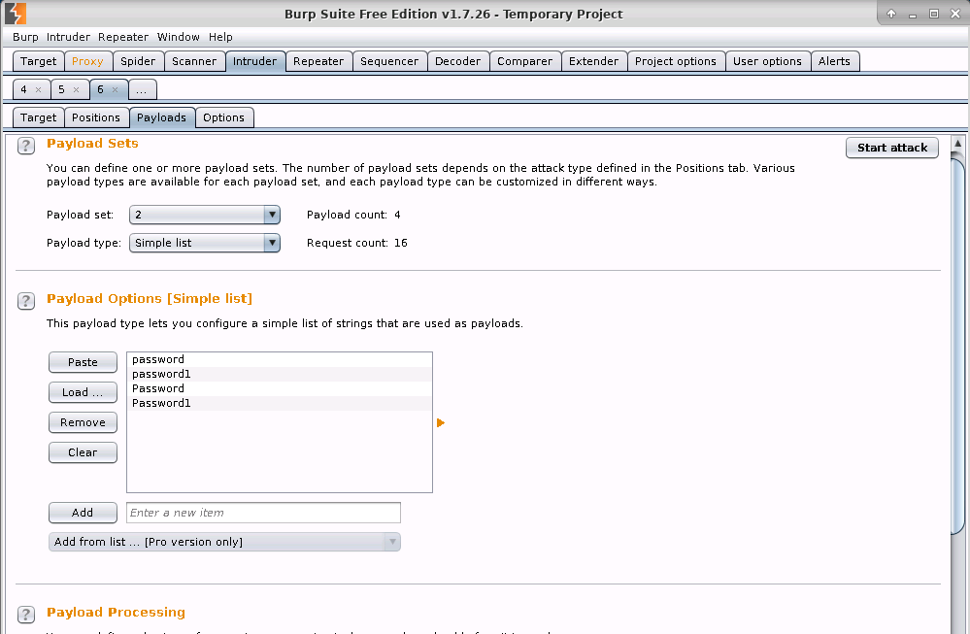
Penetration 9 continued
Notes:
Added possible user names to the 1st payload set and then added possible passwords to the 2nd payload set

Slide 27
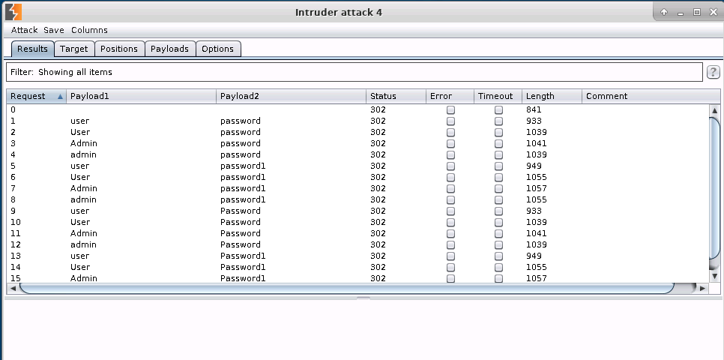
PEnetration 9 continued
Notes:
Launched the attack and these are the results and the combination with the lowest length is the best possible combination that could possibly get you in

